Slide 1
Wave Analysis Workshop
Go through some slides that generally describe the steps in the script and things to watch out for.
Go through the demo data & matlab script step by step.

Slide 2
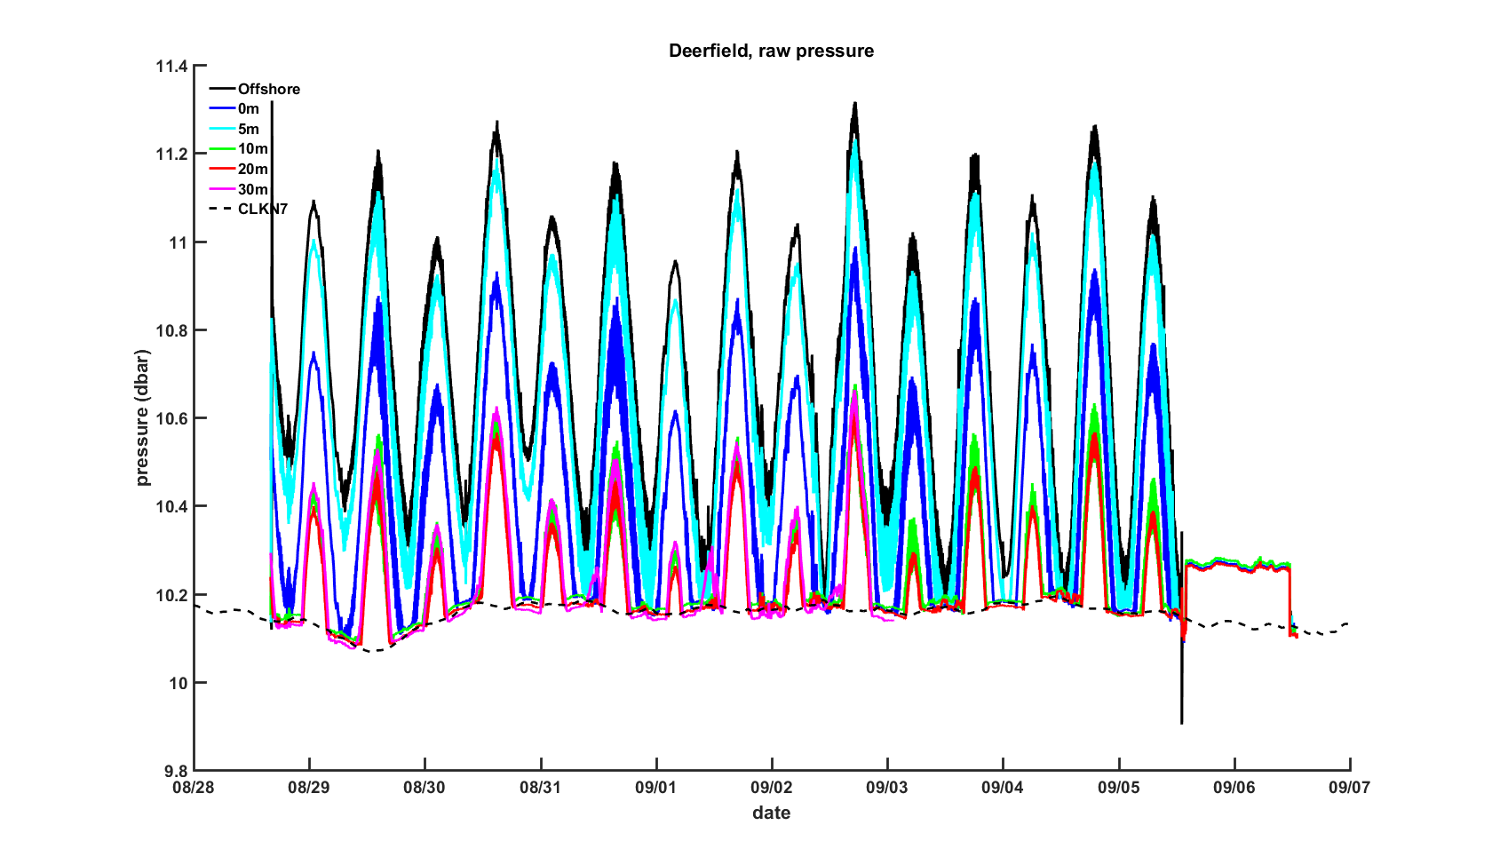
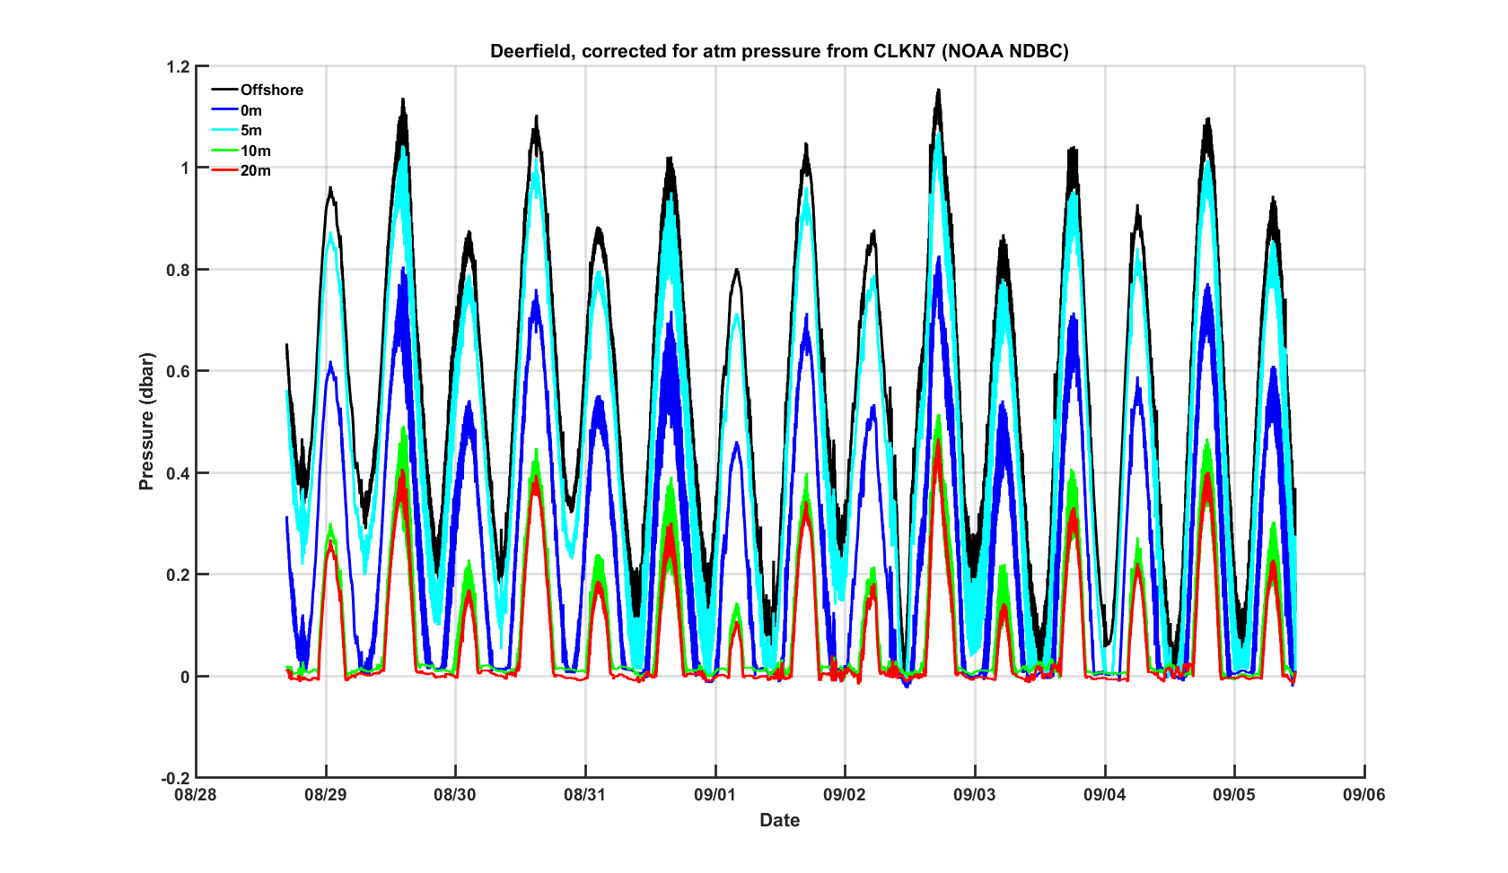
Preparing the pressure data
Calibrate for systematic sensor errors
Remove atm pressure from total pressure

Slide 3
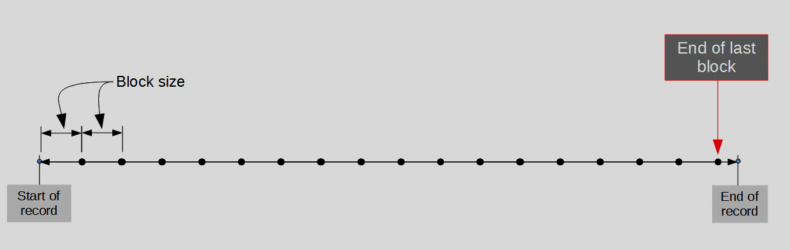
Spectral analysis of pressure data
Spectral analysis on each data block
The main idea is that any arbitrary time series can be represented by the appropriate linear superposition of wave forms

Slide 4
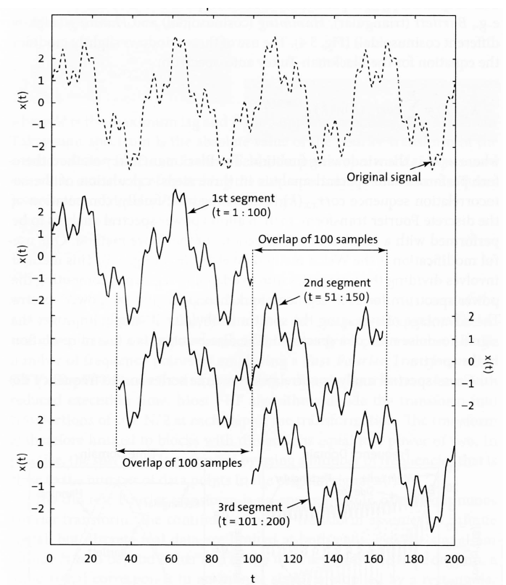
Inside each block:
Notes:
Fig from Trauth text

Slide 5
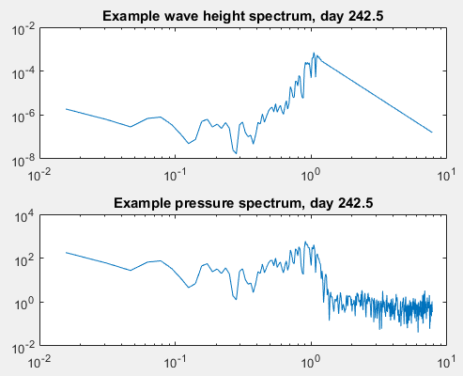
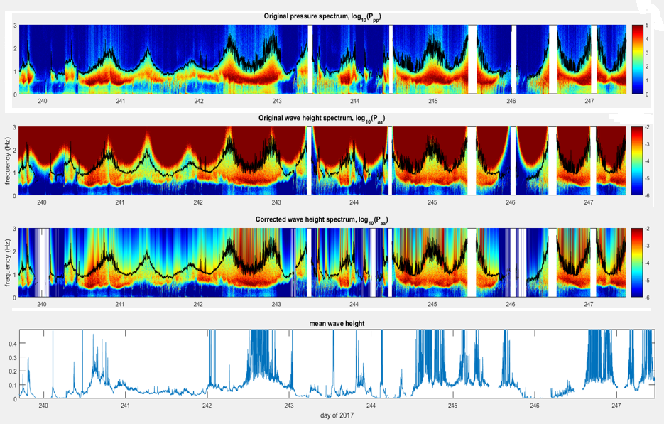
Spectral analysis
2 minute blocks (1920 samples per block)
nfft = 2^10
Hanning window
Cutoff frequency & noise floor…
Extrapolation below cutoff:
f^-4 fit, over 9 indices, with 10^-5 initial values for coefficients.
Notes:
Bad blocks = if cutoff frequency is not sufficiently high relative to wave peak;
if cutoff frequency is too low
if no value of the spectrum is sufficiently larger than the noise floor
5

Slide 6
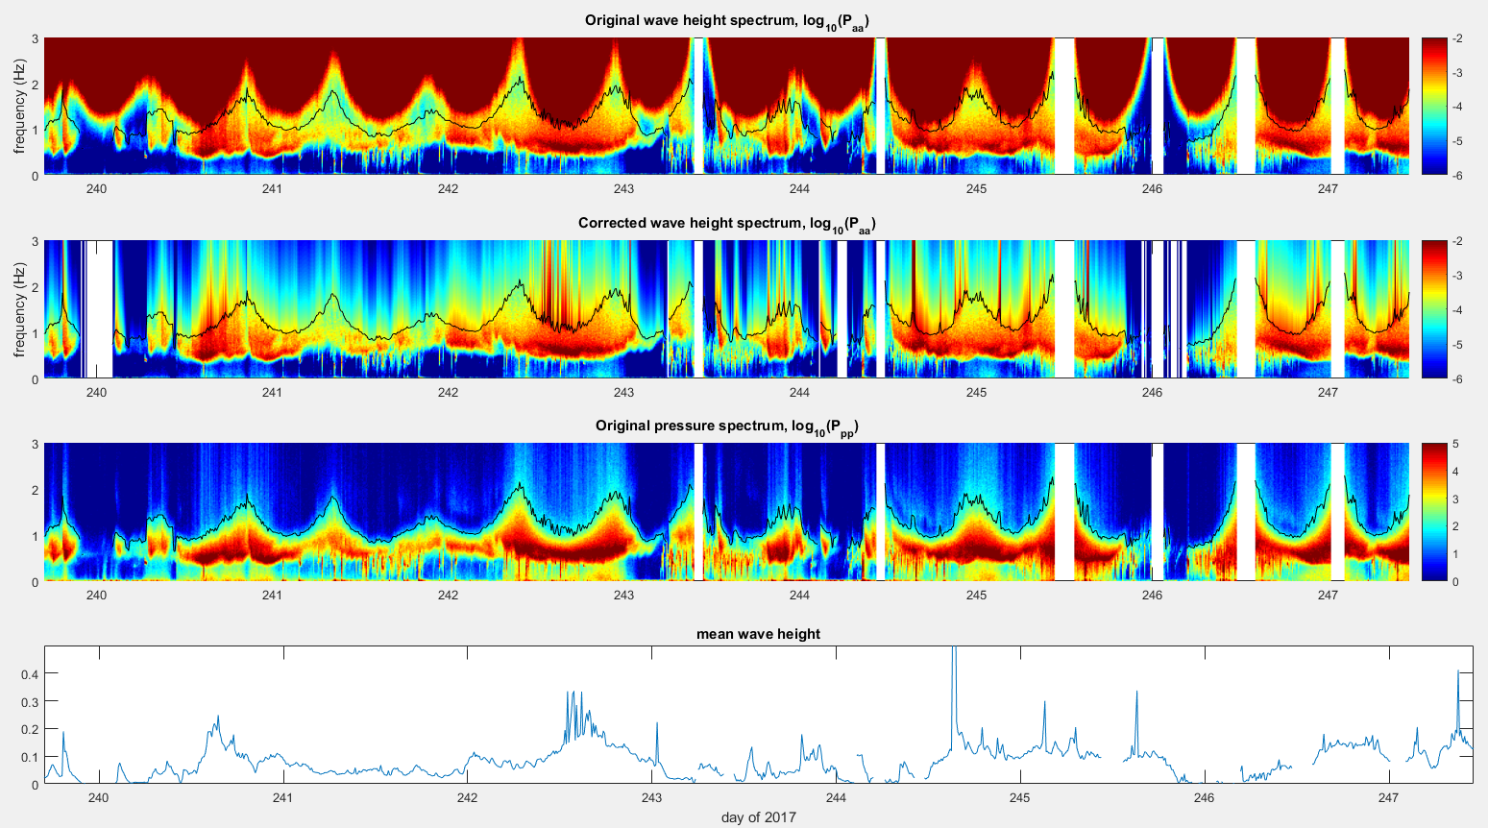
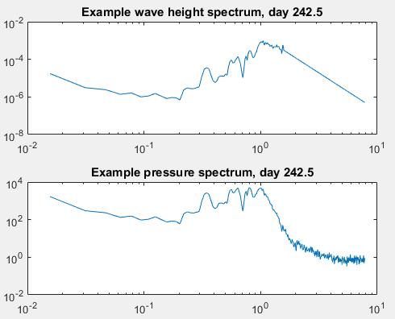
Spectral analysis – effect of block size
10 minute blocks (9600 samples per block)
nspec = 2^10
Hanning window
Noise floor = 2/3
Noise floor cut off = 50*Ppp_noise
Extrapolation below cutoff:
f^-4 fit, over 9 indices, with 10^-5 initial values for coefficients.
Notes:
Bad blocks = if cutoff frequency is not sufficiently high relative to wave peak;
if cutoff frequency is too low
if no value of the spectrum is sufficiently larger than the noise floor
6

Slide 7
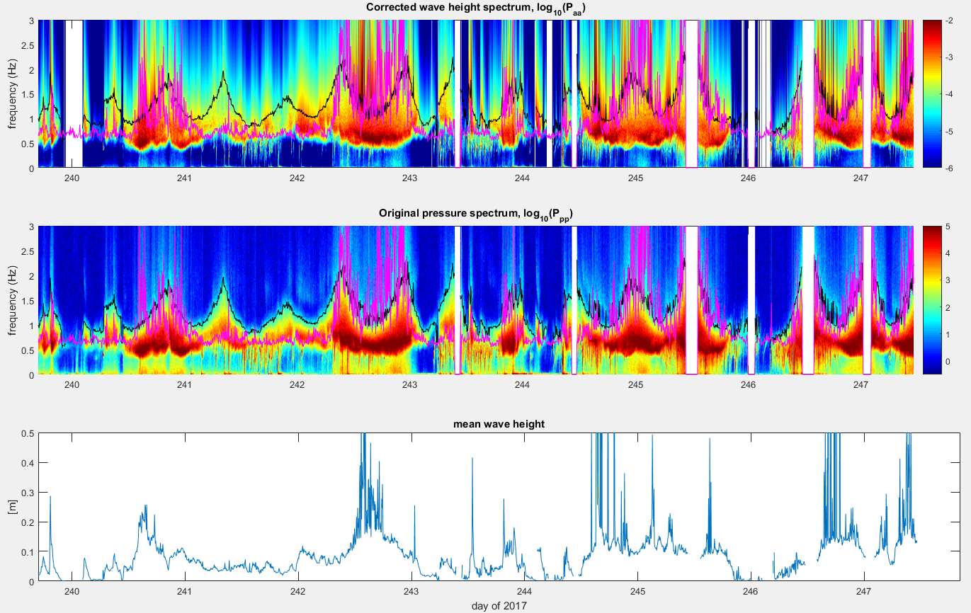
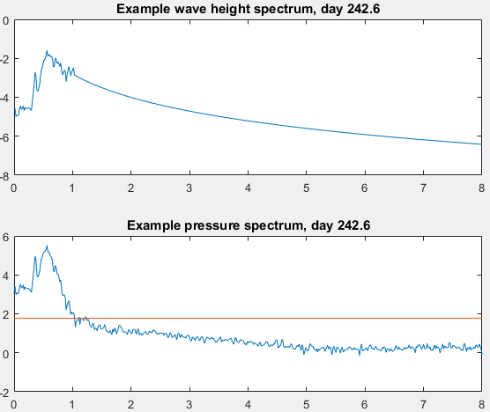
Spectral analysis – effect of noise cutoff
5 minute blocks (4800 samples per block)
nspec = 2^10
Hanning window
Noise floor = 0.67*length(f)
Cutoff=50*Ppp_noise
Extrapolation below cutoff:
f^-4 fit, over 9 indices, with 10^-5 initial values for coefficients.
Ppp_noise
fit
noise floor

Slide 8
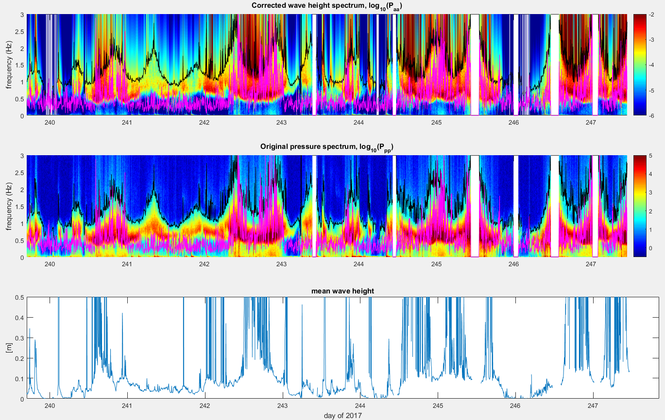
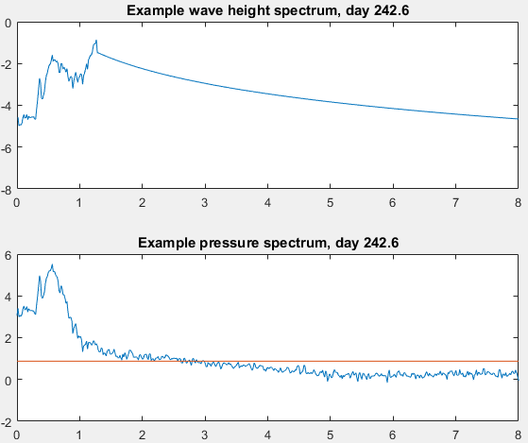
Spectral analysis – effect of noise cutoff
5 minute blocks (4800 samples per block)
nspec = 2^10
Hanning window
Noise floor = 1.0*length(f)
Cutoff=50*Ppp_noise
Extrapolation below cutoff:
f^-4 fit, over 9 indices, with 10^-5 initial values for coefficients.
Ppp_noise
fit
noise floor

Slide 9
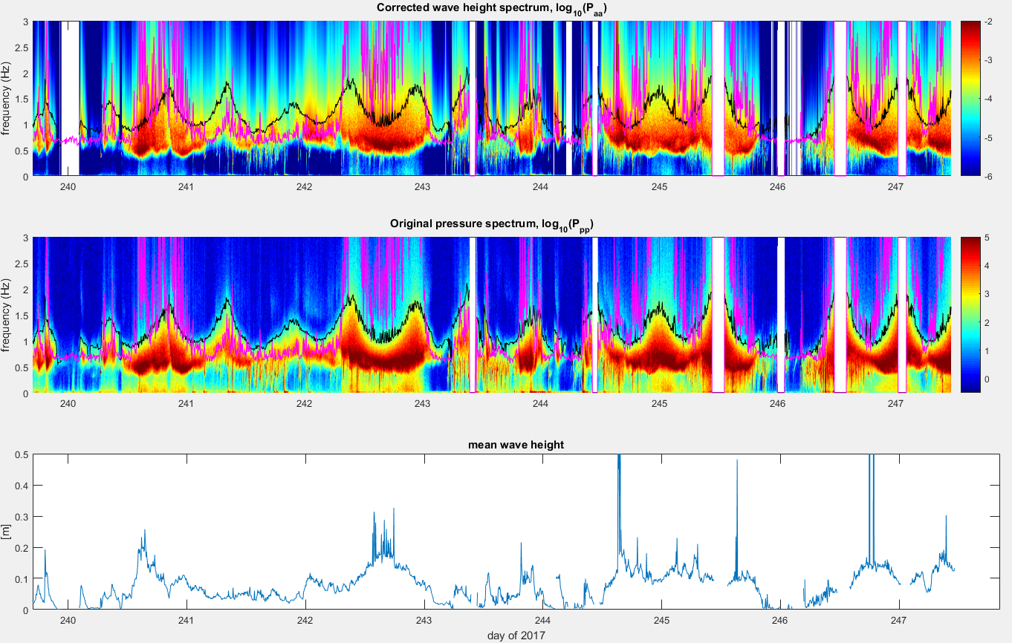
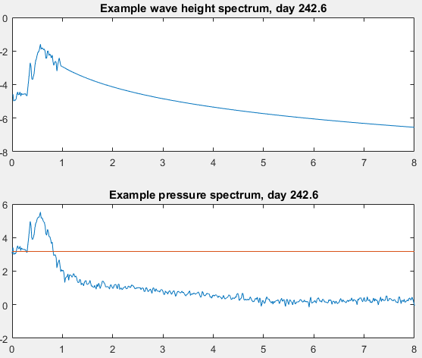
5 minute blocks (4800 samples per block)
nspec = 2^10
Hanning window
Noise floor = 0.3*length(f)
Cutoff=50*Ppp_noise
Extrapolation below cutoff:
f^-4 fit, over 9 indices, with 10^-5 initial values for coefficients.
fit
noise floor

Slide 10
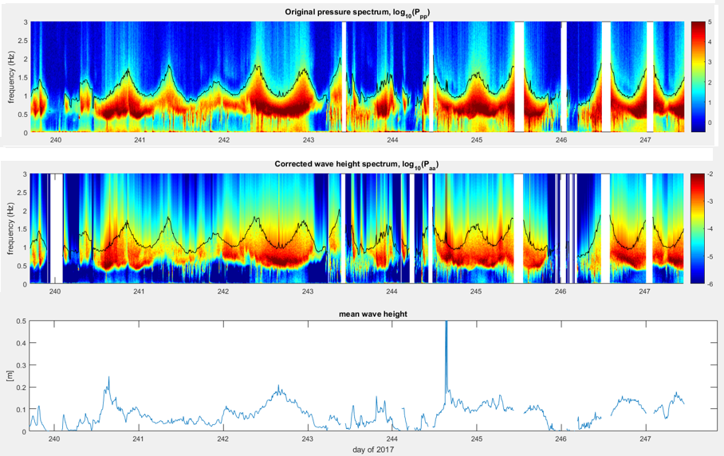
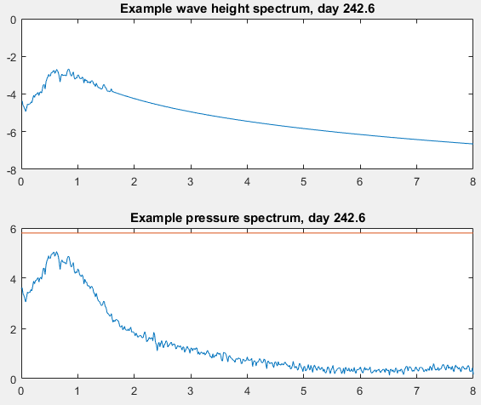

Spectral analysis
10 minute blocks (9600 samples per block)
nspec = 2^10
Hanning window
Noise floor & Cutoff
Extrapolation below cutoff:
f^-4 fit, over 20 indices, with 10^-5 initial values for coefficients.
fit
Larger blocks allow for more of the noise in the original pressure spectrum to be averaged and smoothed out
Notes:
10

